Slide 1
World Cup 2023
All you need to know -Itinerary

Slide 2
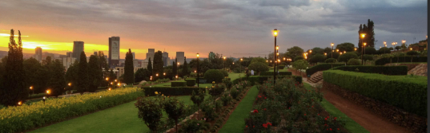
Pretoria
Host City
Ringtennis World Cup 2023
30 September -8 October 2023

Slide 3
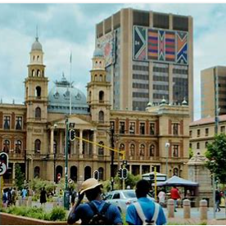
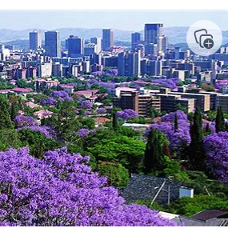
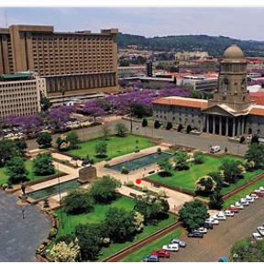
Introduction
Pretoria is South Africa's administrative capital, serving as the seat of the executive branch of government, and as the host to all foreign embassies to South Africa. Pretoria straddles the Apies River and extends eastward into the foothills of the Magaliesberg mountains. It has a reputation as an academic city and center of research, being home to the Tshwane University of Technology, the University of Pretoria, the University of South Africa, the Council for Scientific and Industrial Research, and the Human Sciences Research Council. It also hosts the National Research Foundation and the South African Bureau of Standards. Pretoria was one of the host cities of the 2010 FIFA World Cup. In October it is covered in Purple from the Jacaranda Trees and thus also known as the Jacaranda City.

Slide 4
Team to support you in Pretoria
Theuns Kruger
Jaco du Toit
Yolanda van Staden
Jeanette de la Rey

Slide 5
Itinerary
Arrival
Hotel
Travel to and from the Courts
Courts
Player’s night and Off day

Slide 6
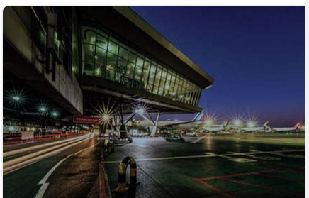
Arrival
Airport – OR Tambo (Johannesburg International) 40 km from Hotel
All Teams will be collected and transported to and from the Airport with Busses
A representative from the Host Union (Gauteng North) or the SA Board will be there to welcome the Teams
A list of Team Members is required to ensure all Members are collected.
All Teams will stay in the same Hotel and will be escorted to the Hotel

Slide 7
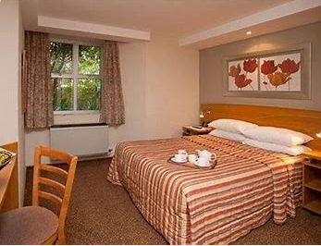
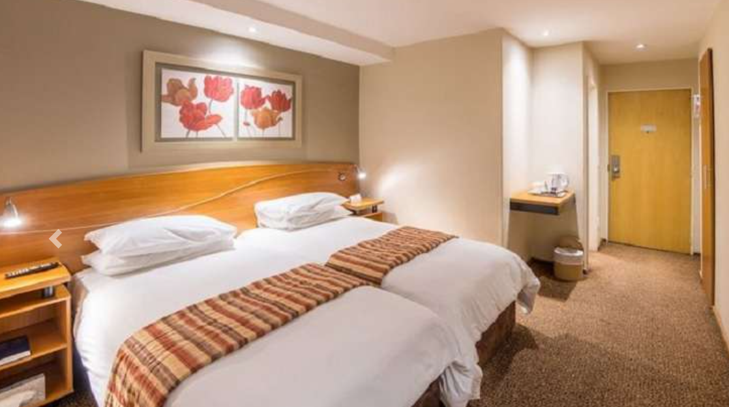
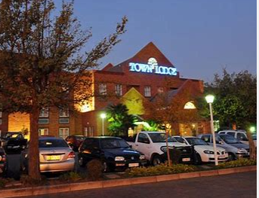
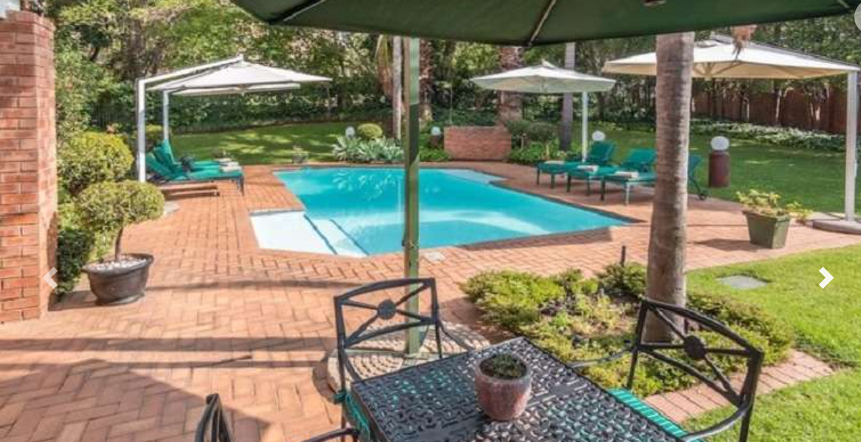
Accommodation -City Lodge Menlyn
Town Lodge Menlo Park, Pretoria, South Africa (south-african-hotels.com)
Double and Single Rooms available
Hotel has sufficient rooms to cater for all Teams and some Supporters if required
Hotel is 16km away from Courts
Closer accommodation alternatives can be provided to Spectators
Hotel offers Dinner, Bed and Breakfast
Players Night will be at Hotel
All Dietary requirements are catered for
Buses will transport players to and from Courts
Hotel is close to Menlyn Mall and Menlyn Maine

Slide 8
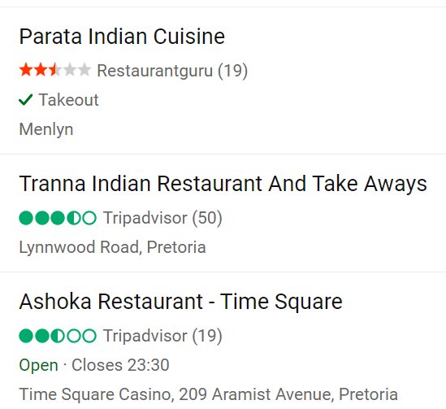
Need to know Information
Foodies
Menlyn is an affluent area in Pretoria and has multiple Eateries that caters for all Cuisines
Health Care
Menlyn Shopping Centre (menlynpark.co.za)
The best restaurants in Hazelwood, Pretoria’s new food hub - Eat Out
Menlyn Maine
Greenlyn Village – Lifestyle Centre Capital Craft and Kapstadt German cuisine
Hotel has WiFi
Sim cards with Data can be bought from Vodacom and MTN at shops on Airport or in Menlyn

Slide 9
Timeline
28 Feb
Confirm Teams to participate in World Cup
11 March
Gauteng North presents to SA Board – all details, cost, full proposal
18 March
Finalize pack to sent to WTF and all participating Teams.
31 May
29 September
All Teams arrive in South Africa at OR Tambo International
Final submission of Players and team registration documents with proof of payment

Slide 10
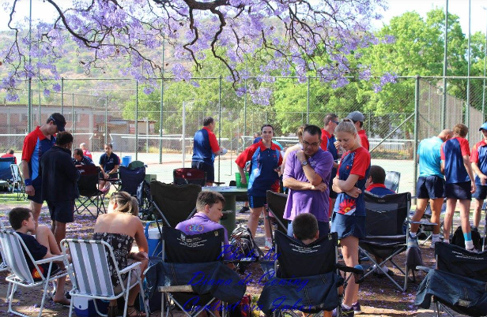
Pretoria Municipal Recreation Club
Venue
Ringtennis Courts
Currently has 20 courts of which 16 will be used for the World Cup
2-4 Ringo Courts will be made available
Lunch will be provided at the Club
Take aways and Snack Bar
Fully Stocked Bar
Safety and Security will be provided
Seating will be provided
Close to Shopping Centers

Slide 11
Summary
Welcome to the World Cup in Pretoria. Gauteng North Tenniquoits/ Ringtennis Union welcomes you to our beautiful City and Courts.

Slide 12
Thank You
Jeanette de la Rey
Jettadlr@gmail.com

